Slide 1
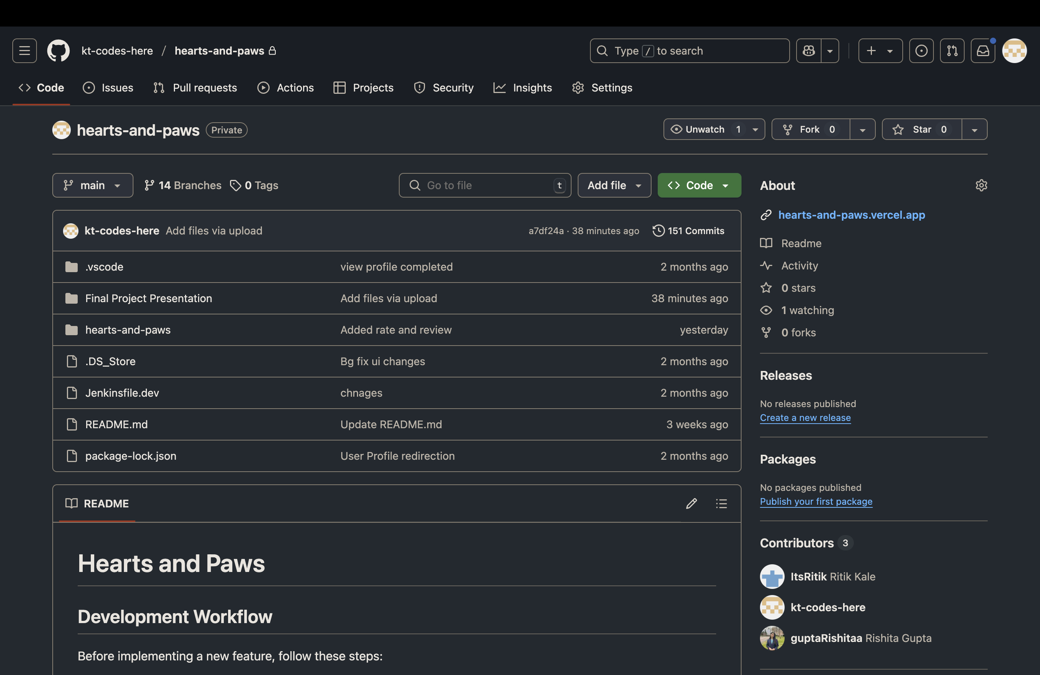
Hearts and Paws GitHub

Slide 2
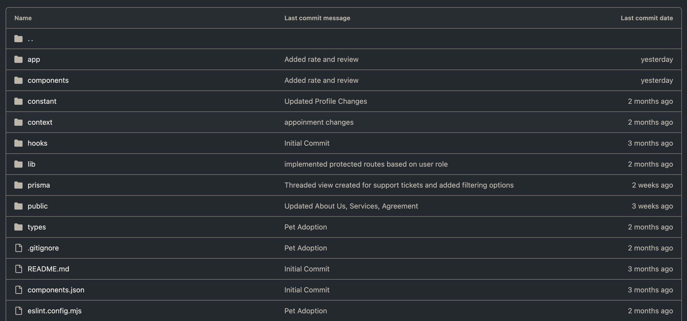

Slide 3
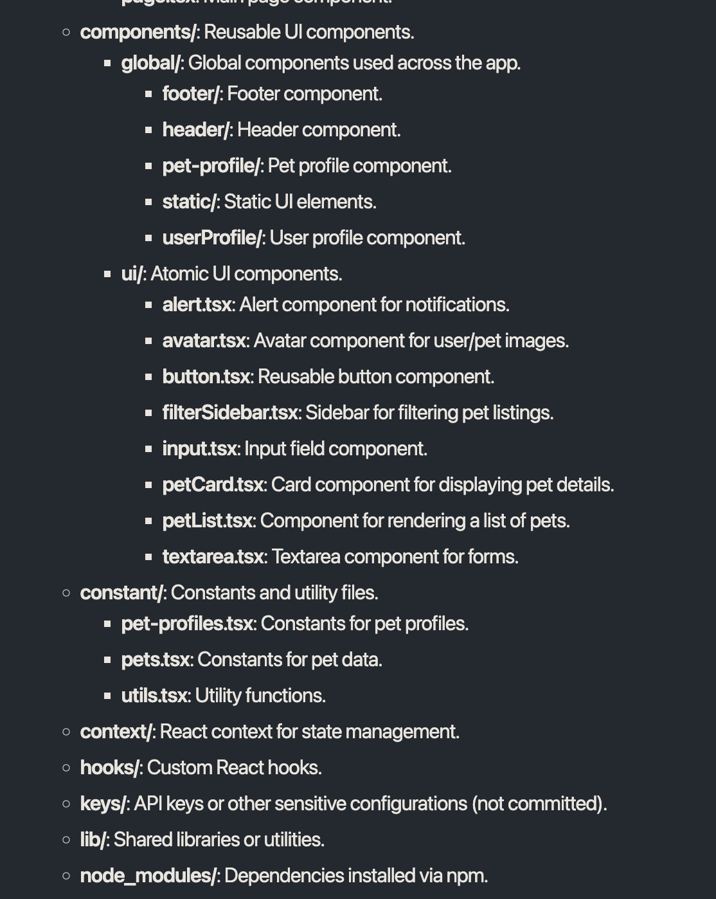
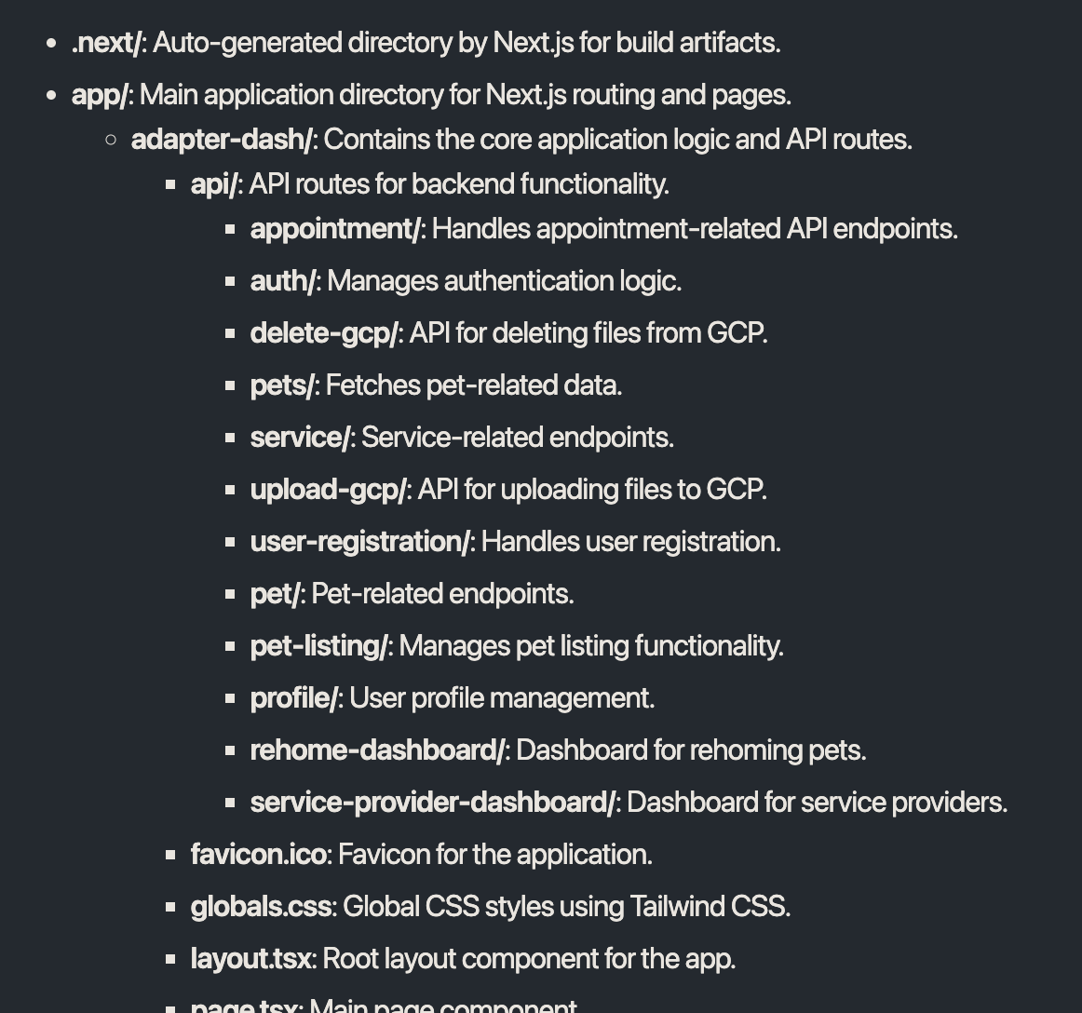
Folder Structure Readme

Slide 4
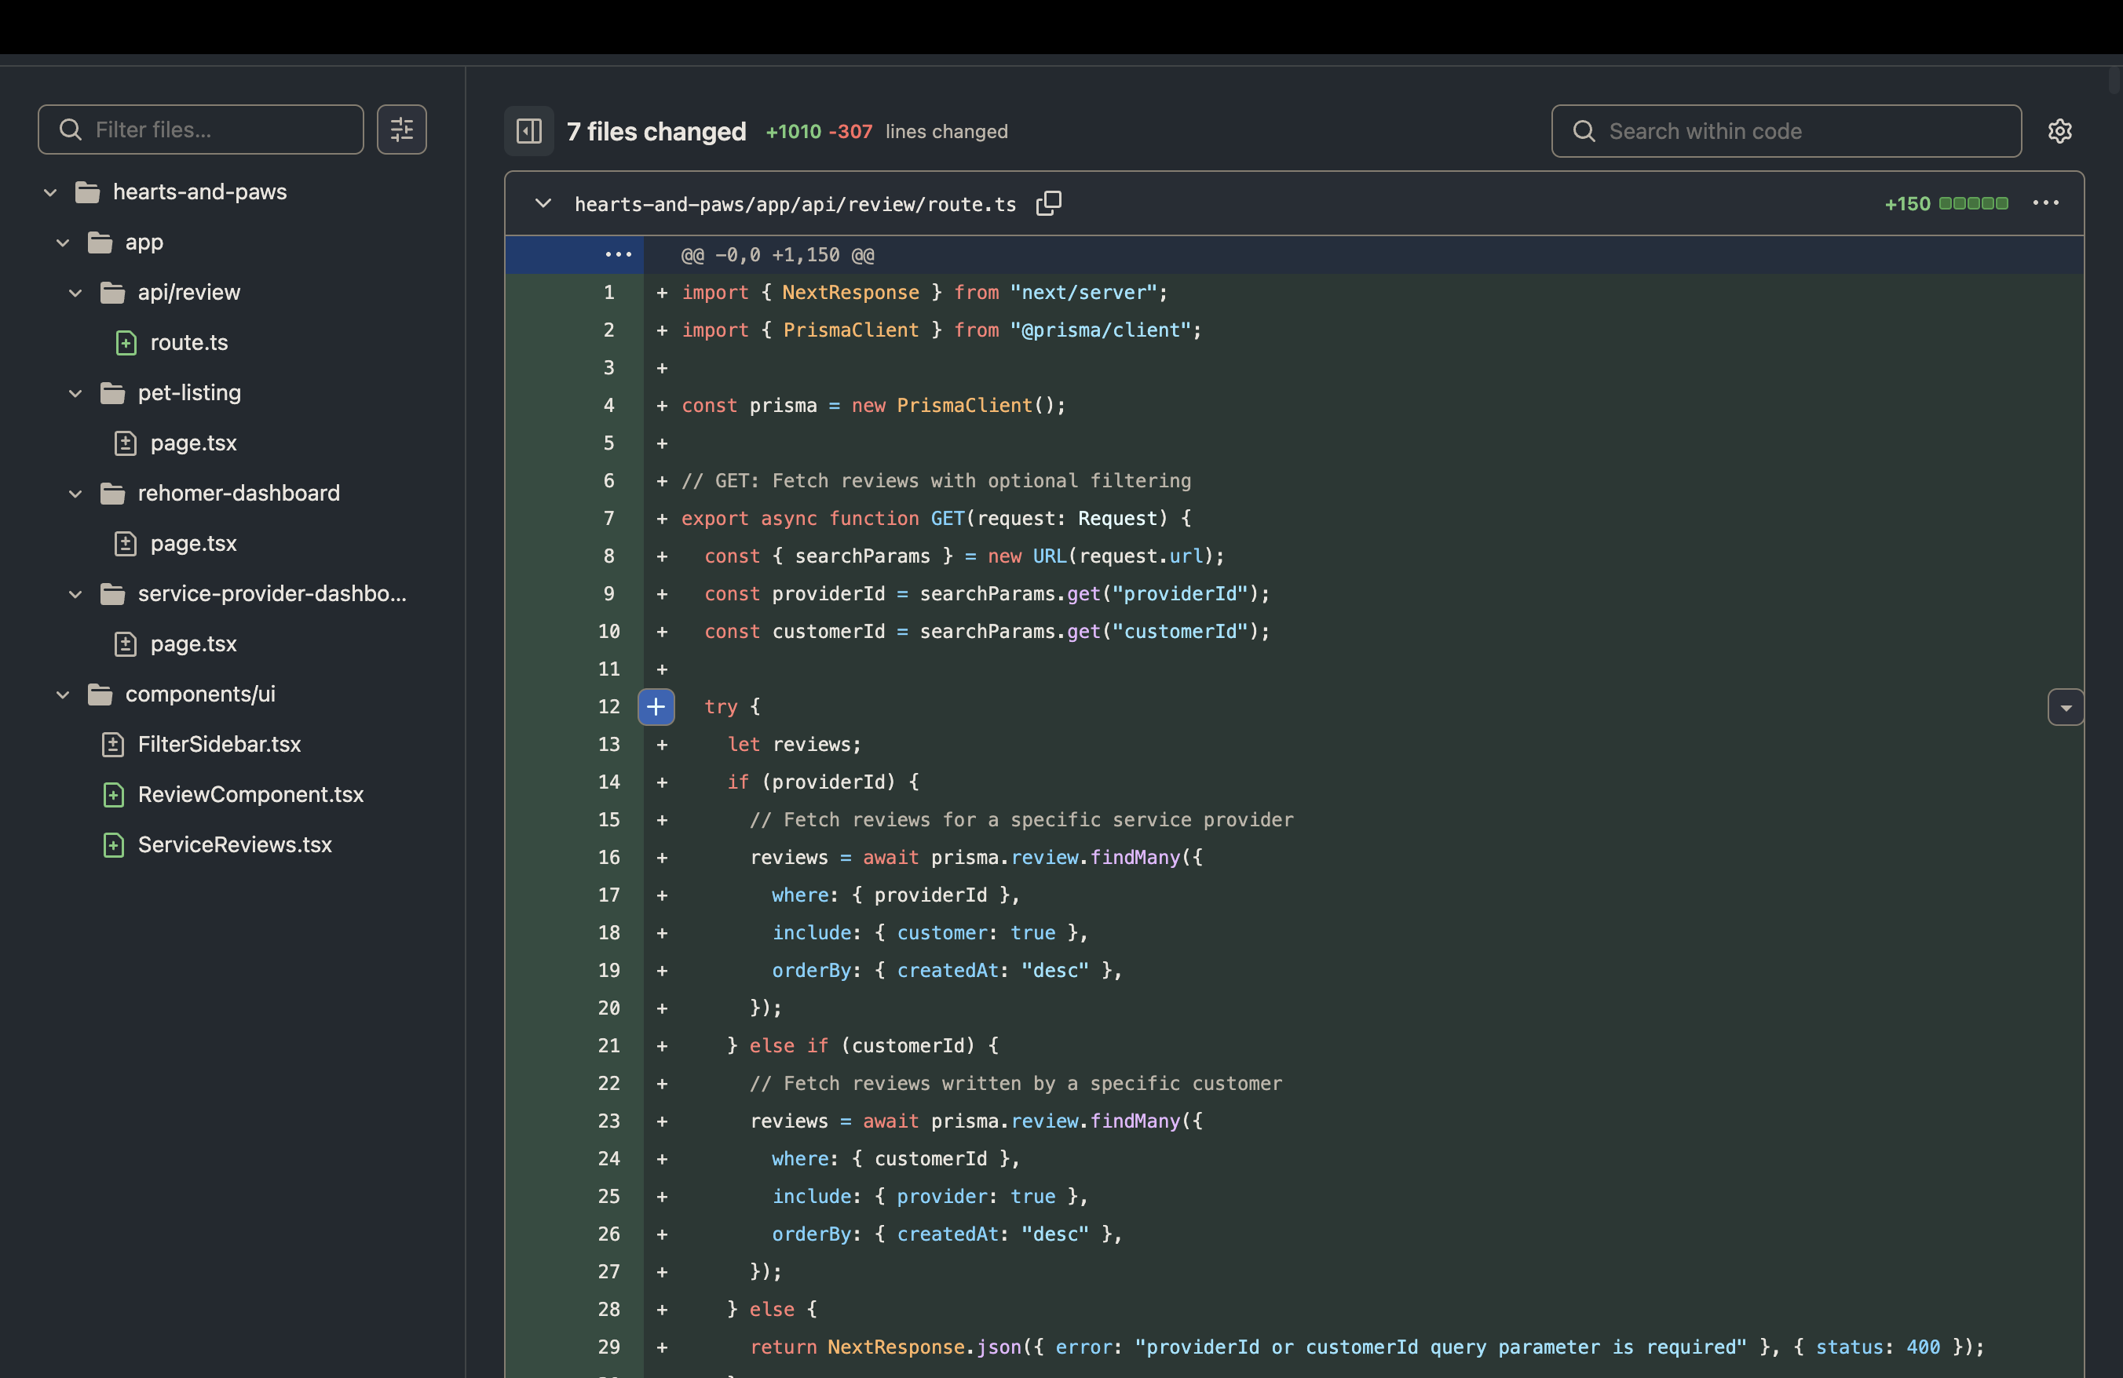
Source Code for Sprint 3: Rate and Review

Slide 5
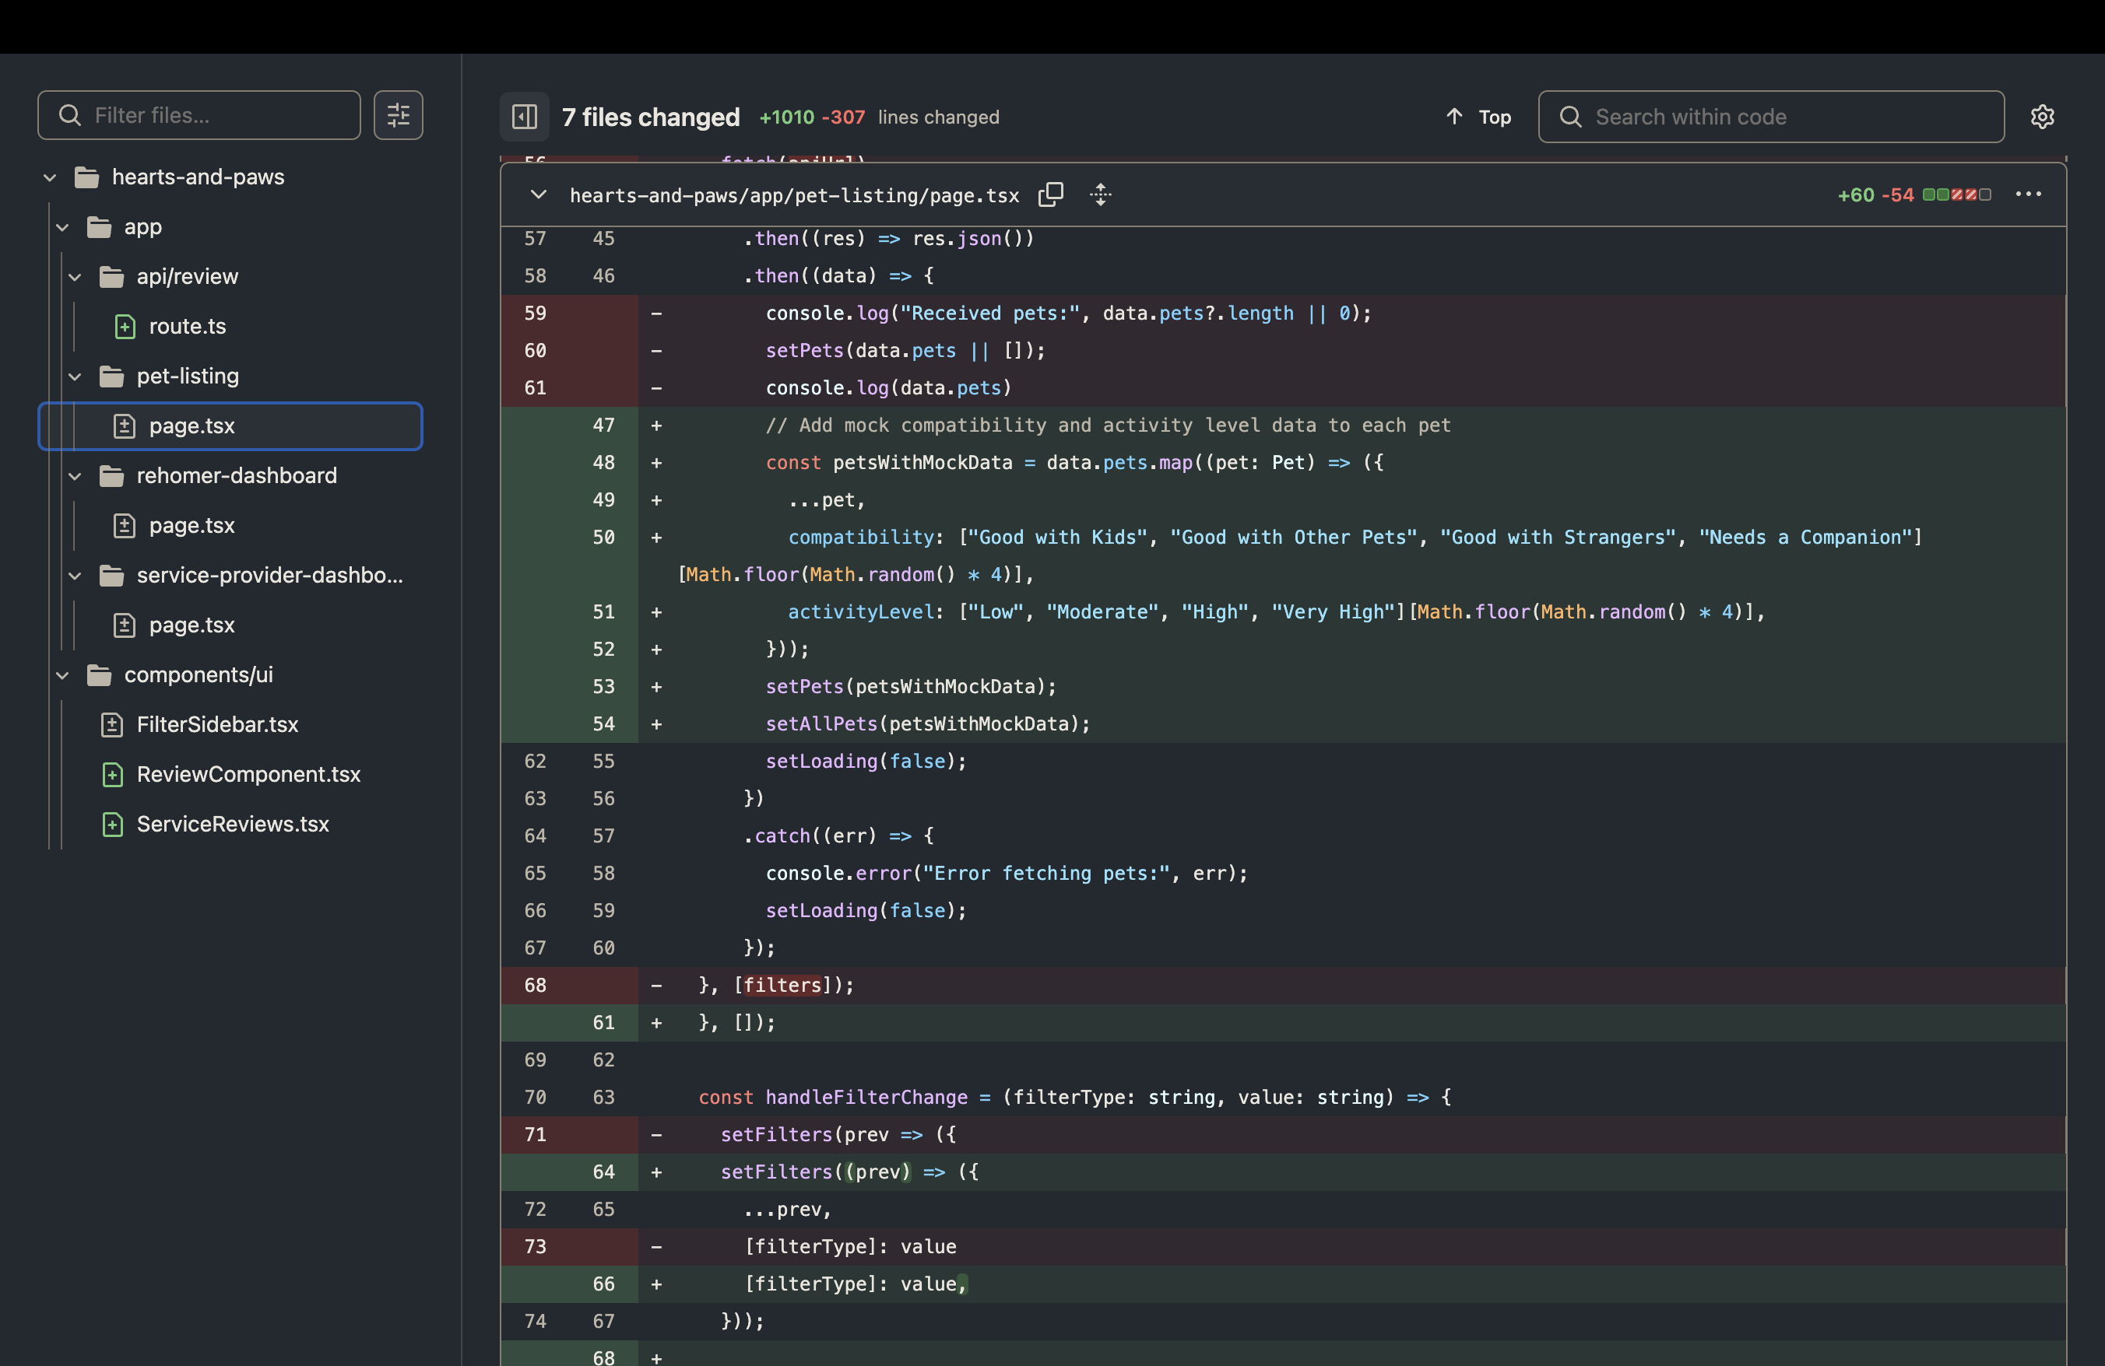
Source Code for Sprint 3: Search Filters

Slide 6
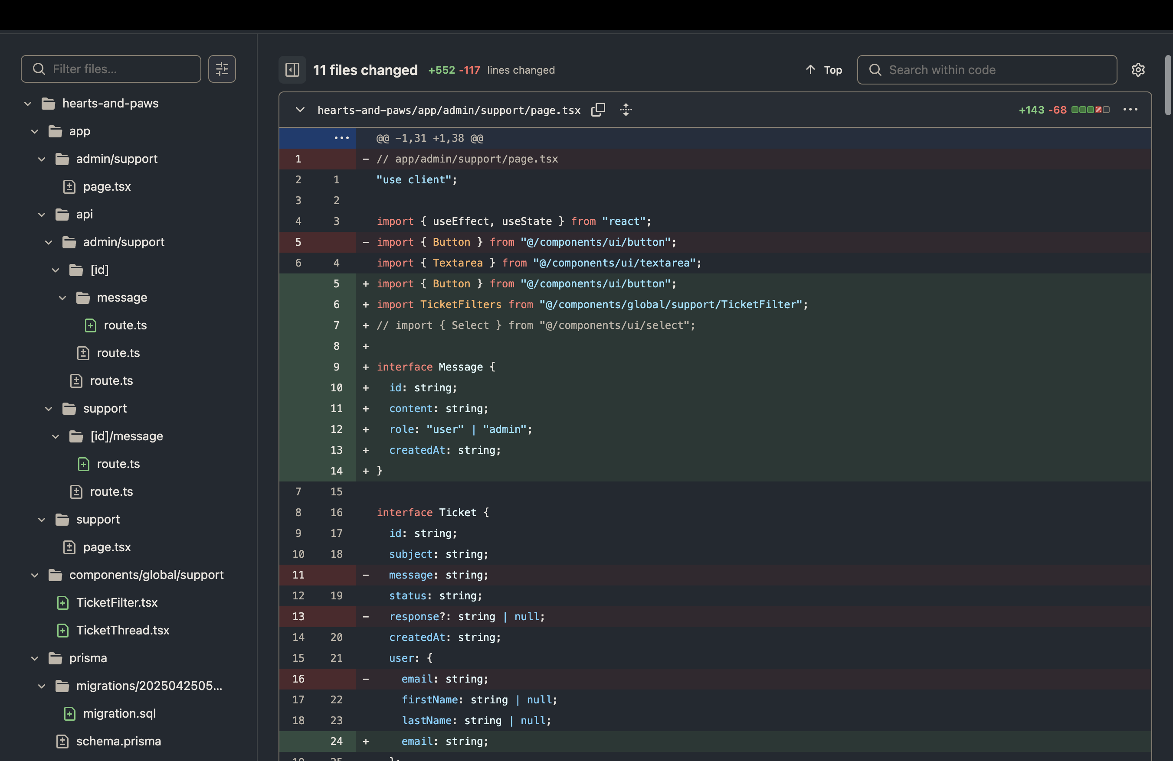
Source Code for Sprint 3: Support Tickets

Slide 7
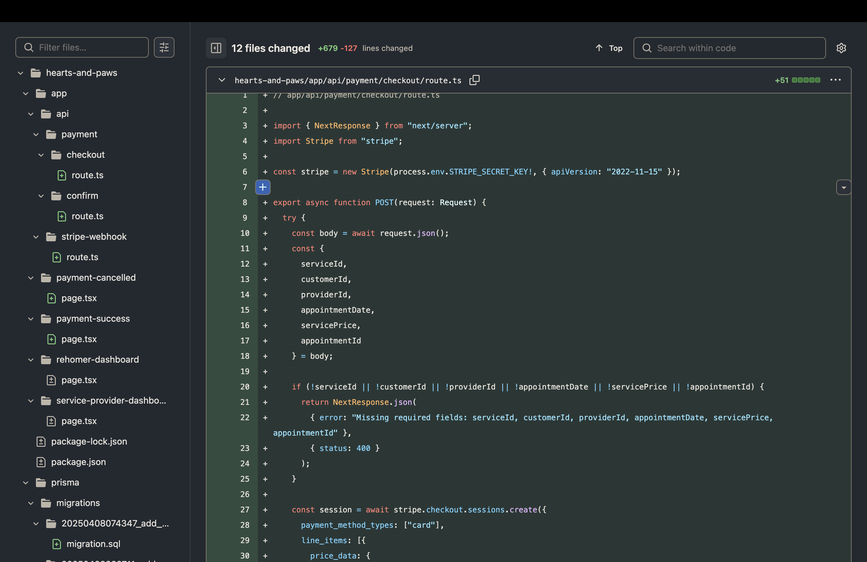
Source Code for Sprint 3: Payment

Slide 8
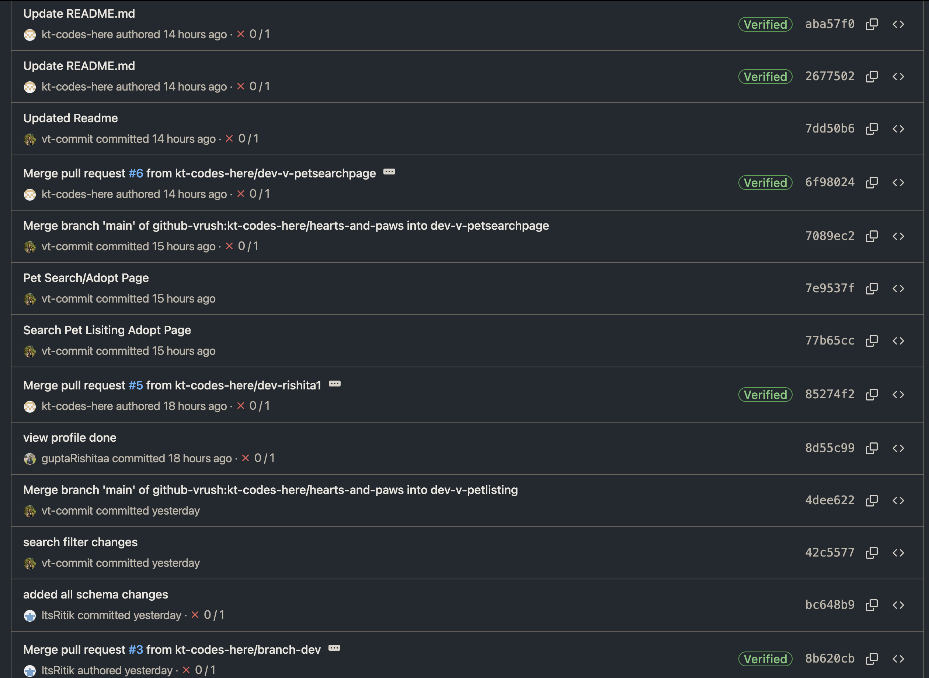
Git Commit History

Slide 9
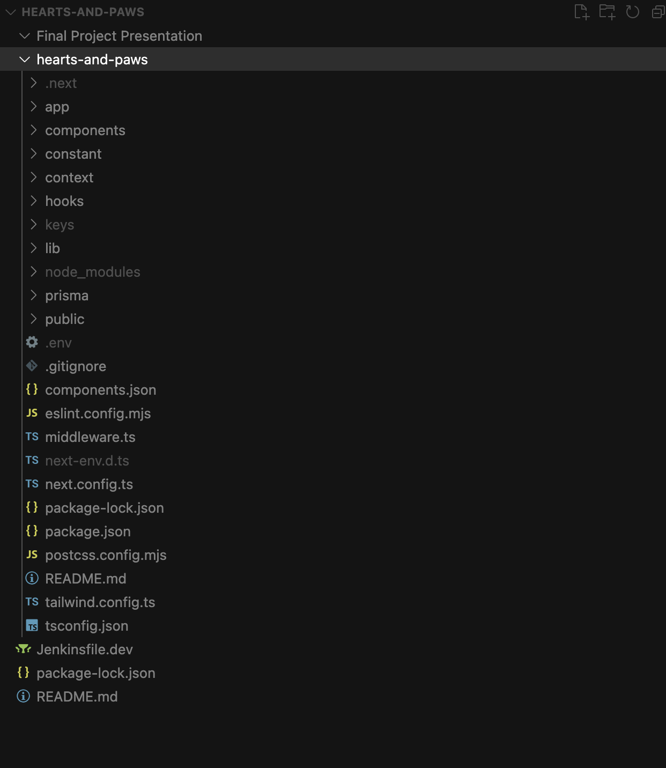
Developer View

